Slide 1
Sparkonics Session 1 tinkercad & Sensors

Slide 2

Intro to Tinkercad
Tinkercad is an online platform for 3D design, electronics, and coding, suitable for beginners.
It is accessible for students, hobbyists, and professionals, allowing easy creation and experimentation.
The platform features tools for 3D modeling, circuit design, and code blocks for project visualization.
Tinkercad promotes learning in STEM fields by providing hands-on simulations and design experiences.

Slide 3
Why simulate ????
It allows real-time feedback, displaying how current flows, voltages across components, and how various elements interact.
Circuit simulation helps detect errors, optimize design, and understand circuit behavior before physically building the circuit.
It eliminates the risk of damaging components and saves time and resources by testing designs digitally before physical implementation.

Slide 4
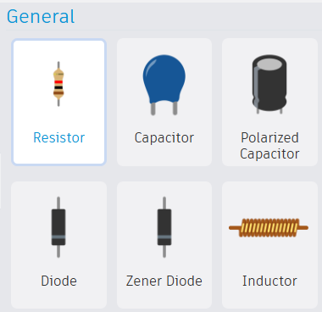
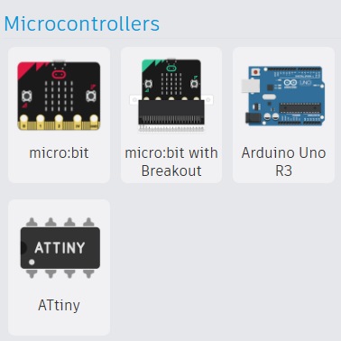
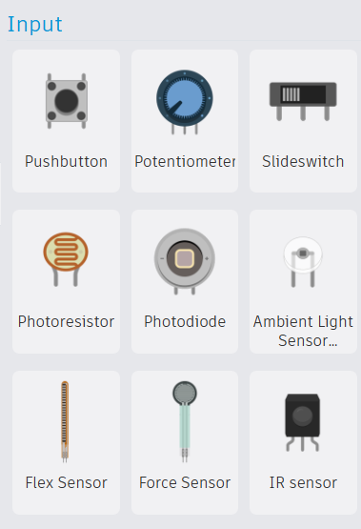
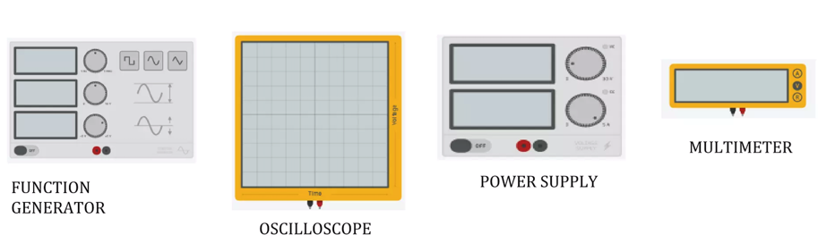
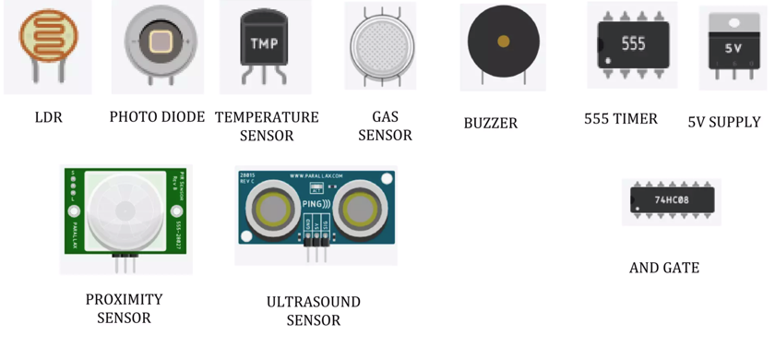
Components available

Slide 5
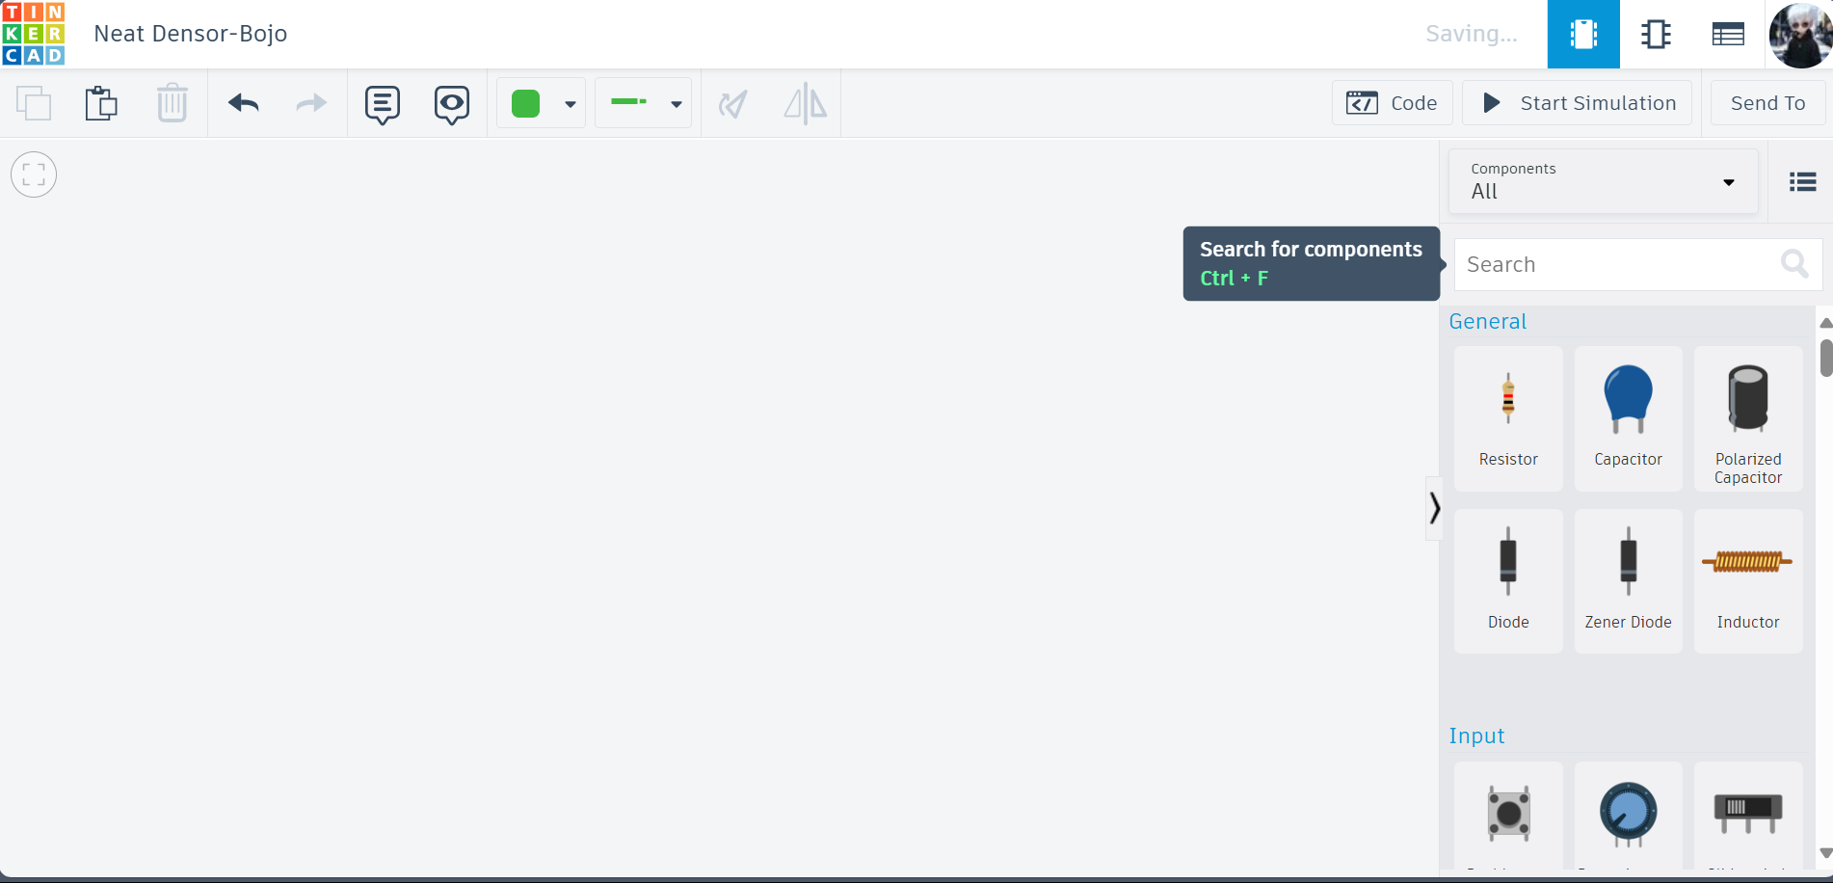
Simulation Name
Circuit View
Schematic View
Component List
Components
Workspace

Slide 6
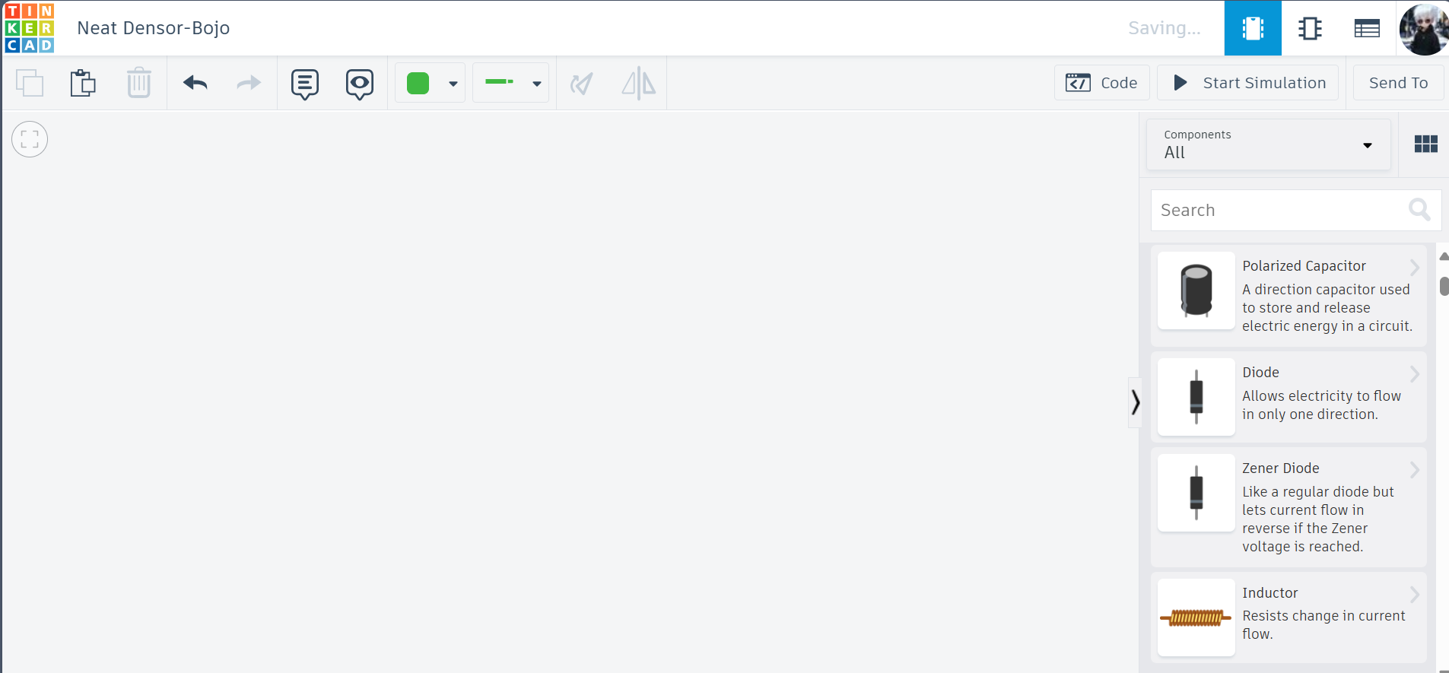

Slide 7
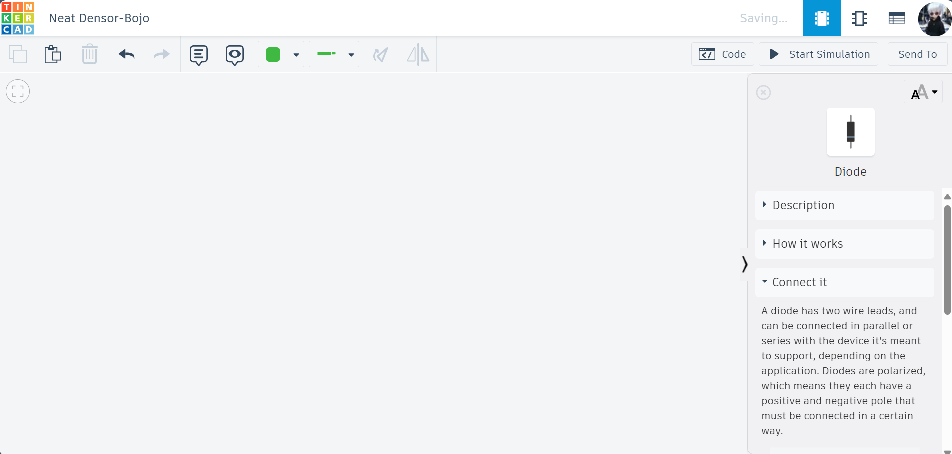

Slide 8
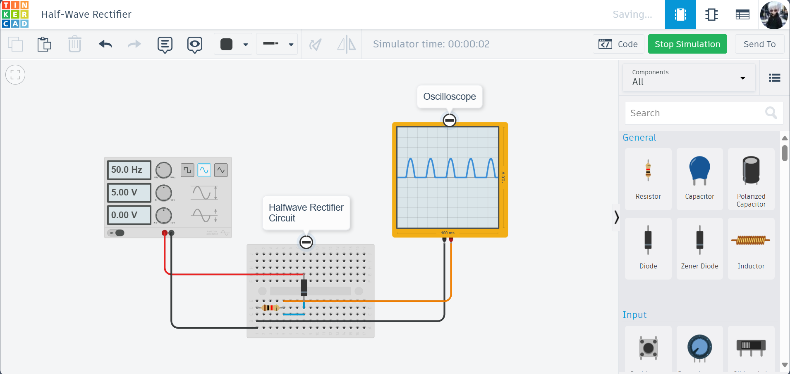

Slide 9
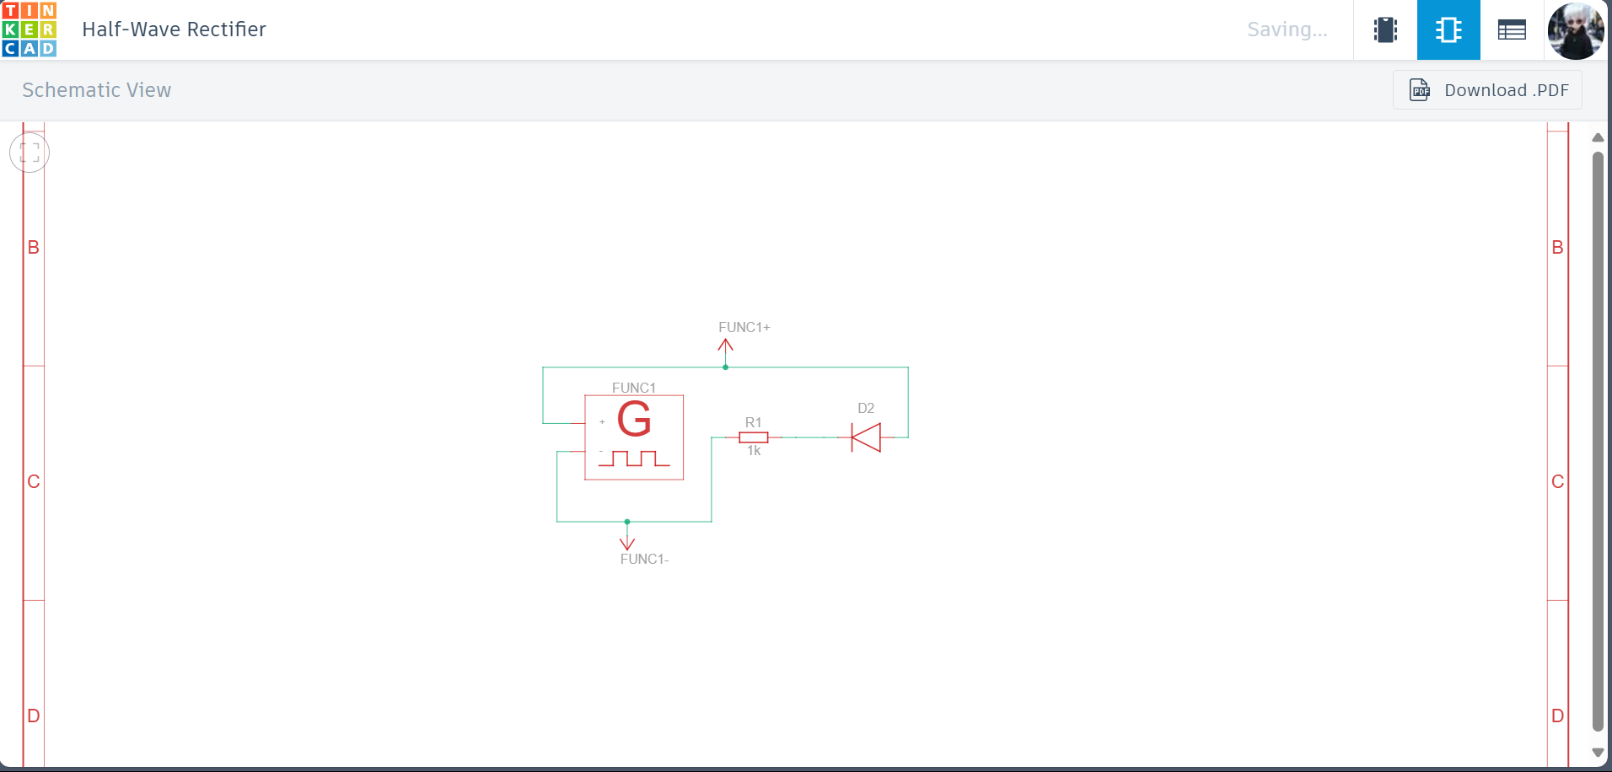

Slide 10
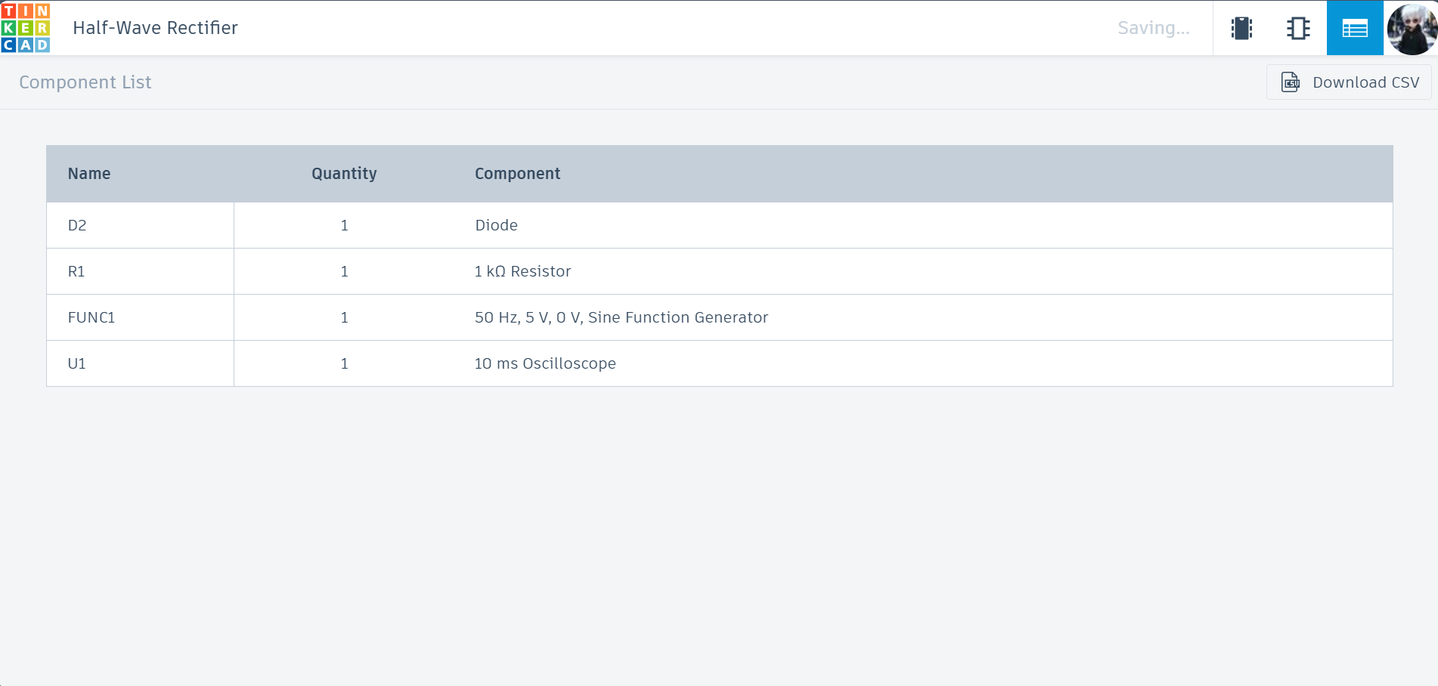
Circuit

Slide 11
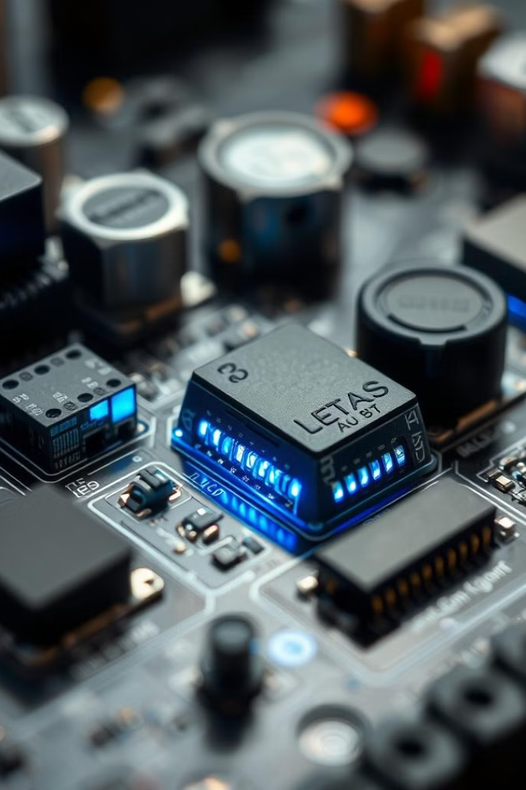

Exploring the World of Sensors
Sensors are revolutionizing how we interact with the world. From smartphones to smart homes, these tiny devices play a big role.

Slide 12
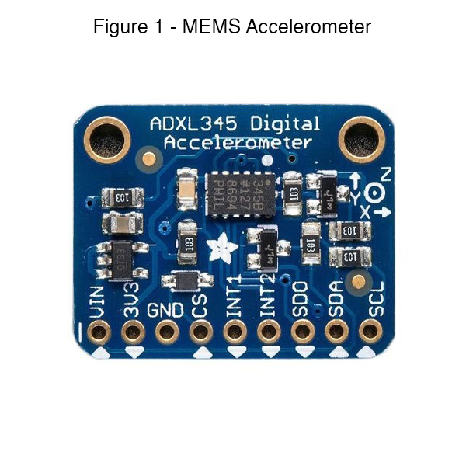
1. Accelerometer
What It Does
Measures linear acceleration in multiple directions (X, Y, Z).
Tracks motion, orientation, and tilt.
Basic Principle
Works on Newton's Second Law of Motion (F = m * a).
MEMS Accelerometers use tiny structures inside that move with acceleration. These movements change the capacitance or resistance, which is converted into measurable signals.
Real-Life Applications
Smartphones: Automatically rotates the screen when tilted.
Fitness Trackers: Counts steps by detecting the up-and-down motion of walking or running.
Airbags in Cars: Detects sudden deceleration in a crash and triggers the airbags.
Future Vision
Smart Prosthetics: Where accelerometers help monitor and adapt movements in real-time.
Health Monitoring: Wearable devices that track even minute changes in motion for early diagnosis of health conditions.

Slide 13
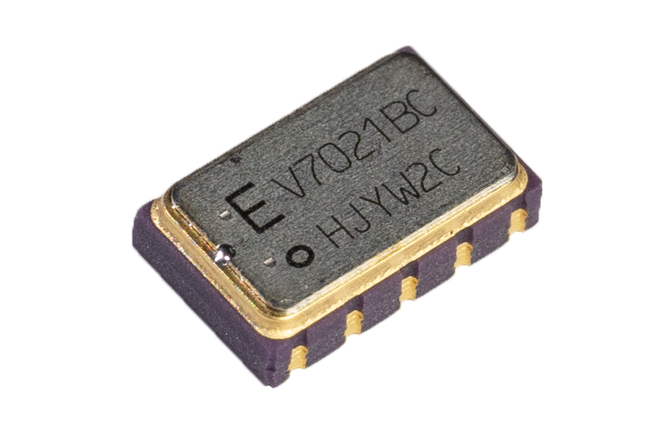
2. Gyroscope
What It Does
Measures angular velocity or rotation along an axis.
Tracks rotational movements to help stabilize and orient devices.
Based on the Coriolis Effect, where a rotating mass inside the sensor experiences forces that are proportional to the rate of rotation. These forces are measured by the MEMS sensor.
Measures rotation in multiple axes (pitch, roll, yaw).
Real-Life Applications
Drones: Stabilizes flight by detecting rotations and adjusting the propellers accordingly.
Virtual Reality (VR): Tracks head movements to provide immersive experiences.
Gaming Controllers: Used in devices like the Nintendo Wii to detect players' hand motions for interactive gaming.
Future Vision
Autonomous Vehicles: Gyroscopes help maintain vehicle orientation and balance in self-driving cars.
Augmented Reality (AR) Glasses: Enhances user experience by precisely tracking head and eye movements.
Basic Principle

Slide 14
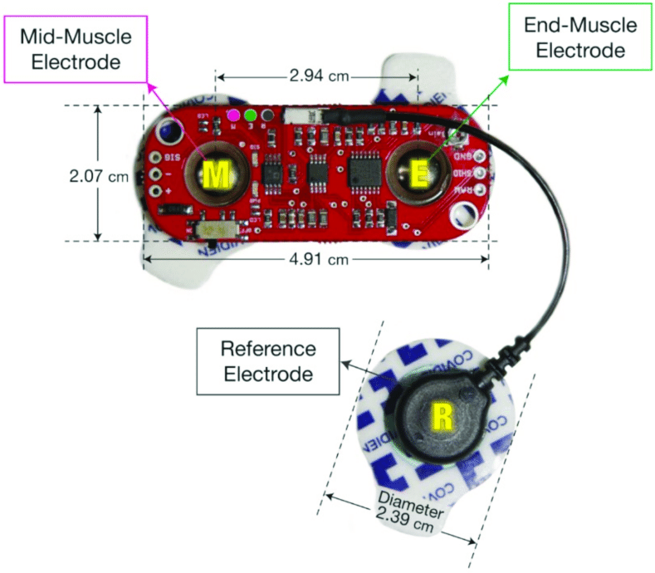
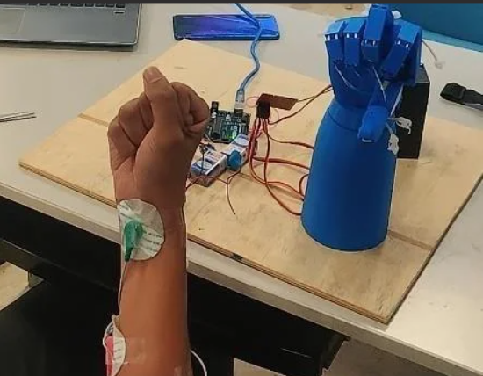
3. EMG (Electromyography) Sensor
What It Does: Tracks electrical signals generated by muscle contractions.
Basic Principle: Measures electrical activity from muscles and translates it into usable data.
Imagine this in Action:
Wearable exoskeletons controlled by your muscle movements, giving new life to rehabilitation.
Where You See It:
Prosthetic limbs, Rehabilitation tools, Sports science (monitoring muscle fatigue).

Slide 15
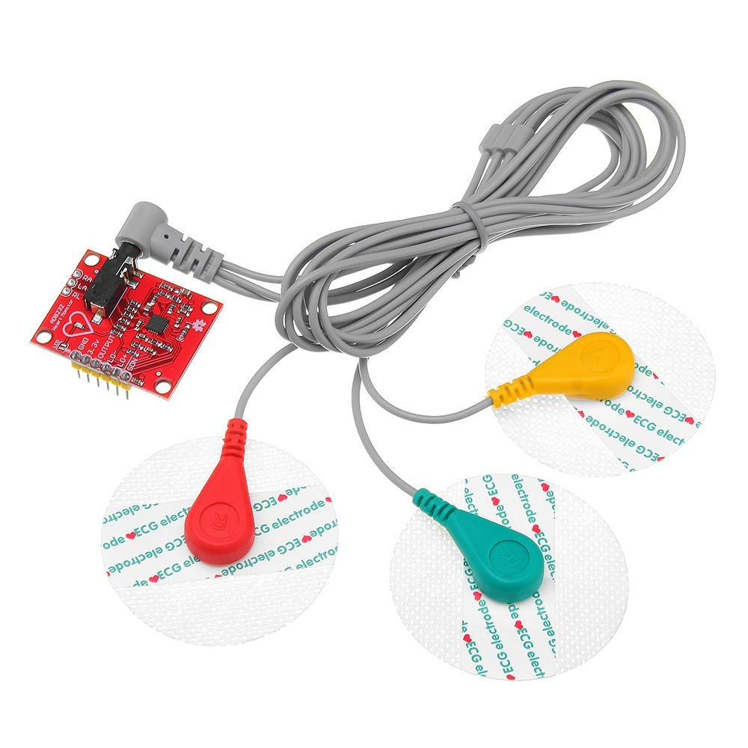
4. ECG (Electrocardiogram) Sensor
What It Does: Measures the heart's electrical activity.
Basic Principle: Captures electrical signals of the heart to produce a waveform representing heart rhythms.
Imagine this in Action:
Your smartwatch silently tracking your heart rate and alerting you if it detects any irregularities, potentially saving lives.
Where You See It:
Smartwatches, Medical diagnostics (detecting heart issues early), Fitness trackers.

Slide 16
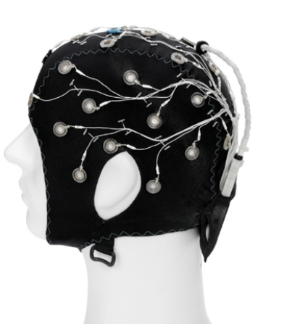
5. EEG (Electroencephalography) Sensor
What It Does: Captures electrical activity in the brain.
Basic Principle: Detects voltage changes in the brain's neurons.
Imagine this in Action:
Brain-Computer Interfaces allowing people to control devices just by thinking.
Where You See It:
Neurological research, Epilepsy diagnosis, Cognitive neuroscience (understanding brain activity in real-time).

Slide 17
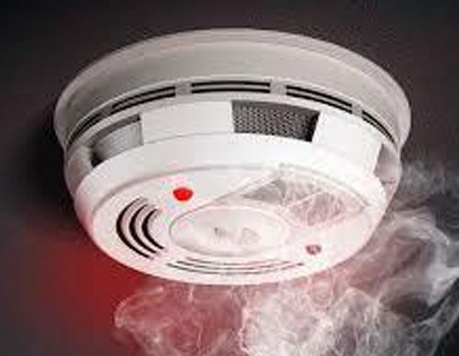
6. Smoke Sensor
What It Does: Detects smoke particles in the air to prevent fire hazards.
Basic Principle: Uses photoelectric or ionization technology to detect smoke particles by measuring light scattering or current disruption.
Imagine this in Action:
Smoke detectors in your home or office that trigger alarms before you even notice danger.
Where You See It:
Fire alarms, Industrial safety systems, Smart homes.

Slide 18
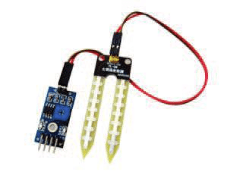
7. Soil Moisture Sensor
What It Does: Measures water content in soil.
Basic Principle: Measures changes in the dielectric constant or electrical conductivity of the soil to indicate moisture levels.
Imagine this in Action:
Smart irrigation systems that water plants when they’re thirsty—saving water and optimizing growth.
Where You See It:
Agriculture, Gardening automation, Environmental monitoring

Slide 19
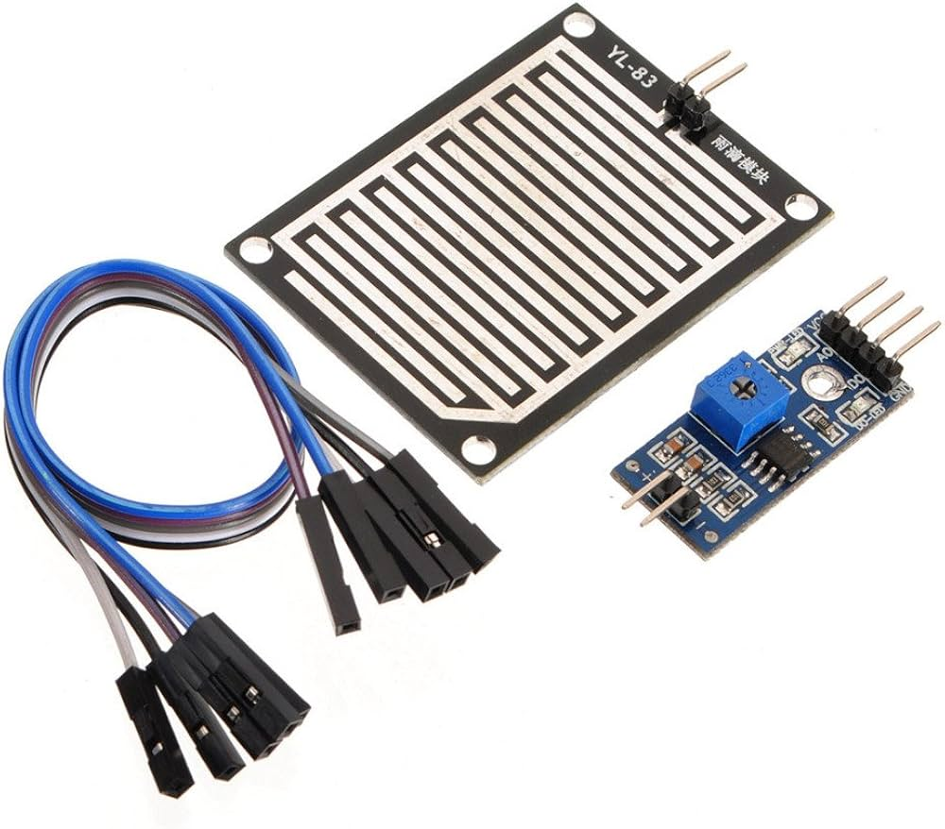
8. Rain Sensor
What It Does: Detects rainfall and triggers automatic responses.
Basic Principle:
Senses rain via changes in resistance or capacitance when raindrops hit a surface.
Where You See It:
Automatic car wipers, Smart irrigation systems, Weather stations.
Imagine this in Action:
Your car’s wipers start automatically when it starts raining—no hands needed.

Slide 20
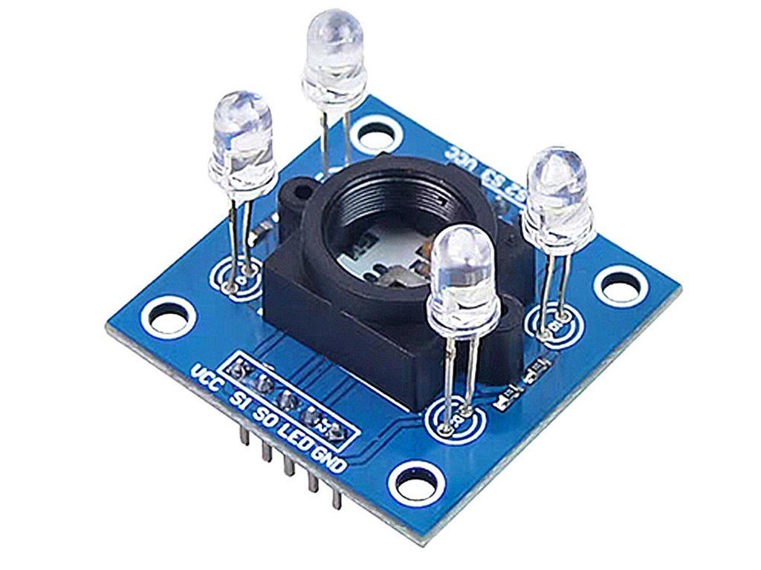
9. Color Sensor
What It Does: Identifies colors by measuring light reflected off surfaces and converting it into RGB values.
Basic Principle: Detects light intensities in the Red, Green, and Blue spectrum to determine color.
Imagine this in Action:
Automatic car wipers, Smart irrigation systems, Weather stations.
Where You See It:
Manufacturing quality control, Robotics, Color matching systems.

Slide 21
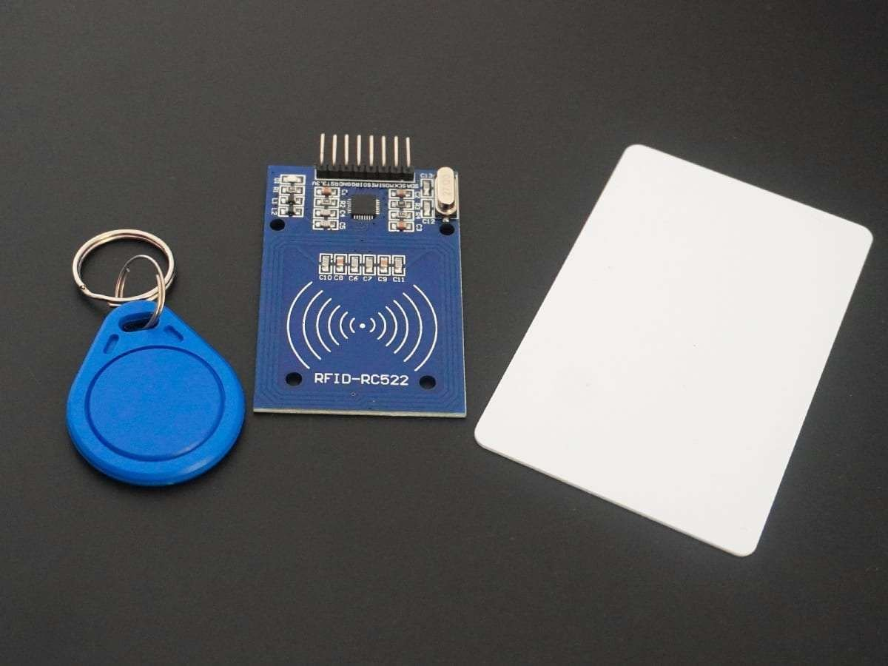
10. RFID (Radio-Frequency Identification) sensor
What It Does: Wirelessly identifies and tracks objects using electromagnetic fields and RFID tags.
Basic Principle: RFID readers emit radio waves that activate tags, which send back data (like an ID or serial number).
Imagine this in Action:
You walk into a building and your RFID access card automatically unlocks the door.
Where You See It:
Access control systems, Inventory management, Contactless payment (e.g., metro cards, credit cards).

Slide 22
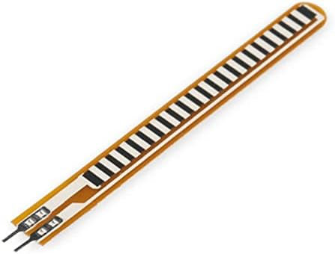
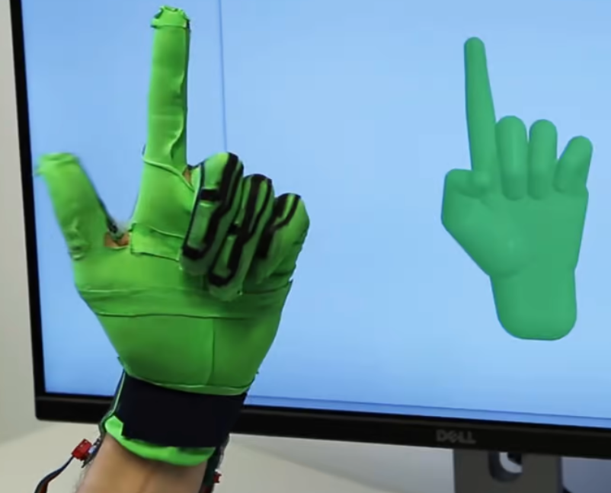
11.Flex Sensor
What It Does:
Measures the amount of bend or flex in a material.
Basic Principle:
The sensor's resistance changes as it bends. The more it bends, the higher the resistance.
Real-Life Applications:
Robotics (detecting joint movement), Wearable Devices, Gaming Controllers.
Future Vision:
Prosthetic limbs with more natural movements, Wearable technology that adapts to user posture.

Slide 23
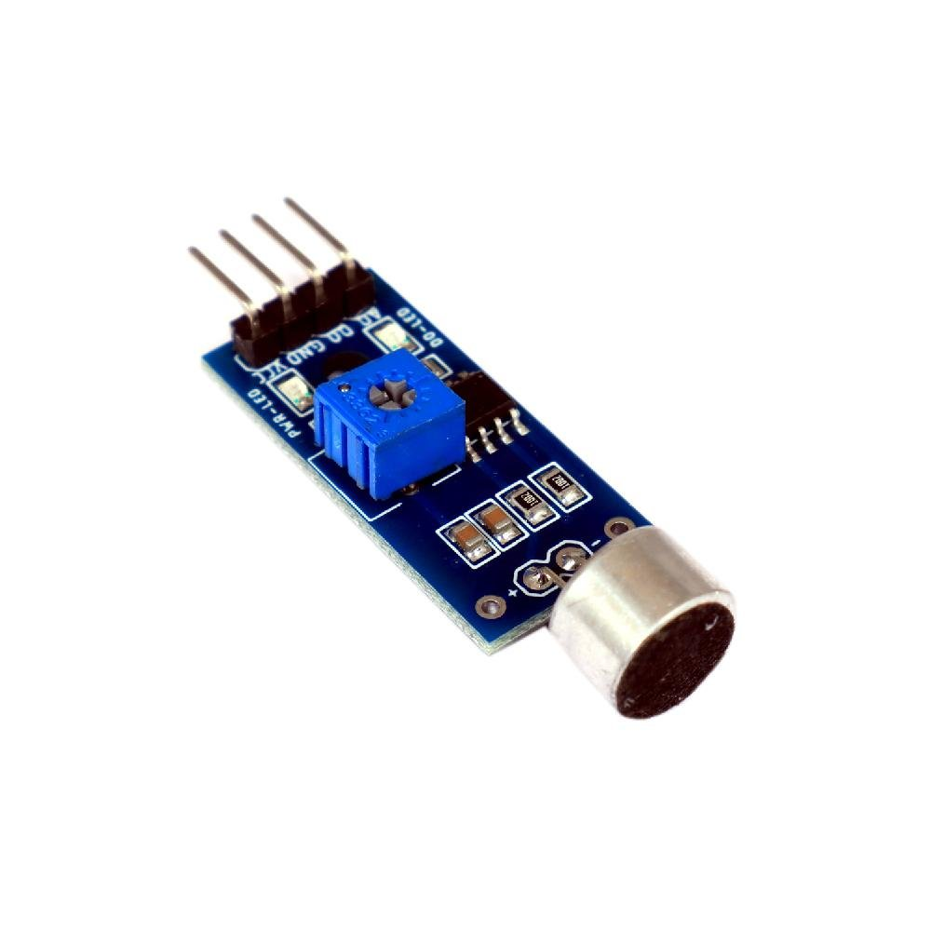
12.Sound Sensor
What It Does:
Measures the sound levels in an environment.
Basic Principle:
Uses a microphone to convert sound waves into electrical signals.
Real-Life Applications:
Voice-activated systems, Environmental monitoring, Smart home systems.
Future Vision:
Advanced voice recognition, Real-time sound analysis for public safety.

Slide 24
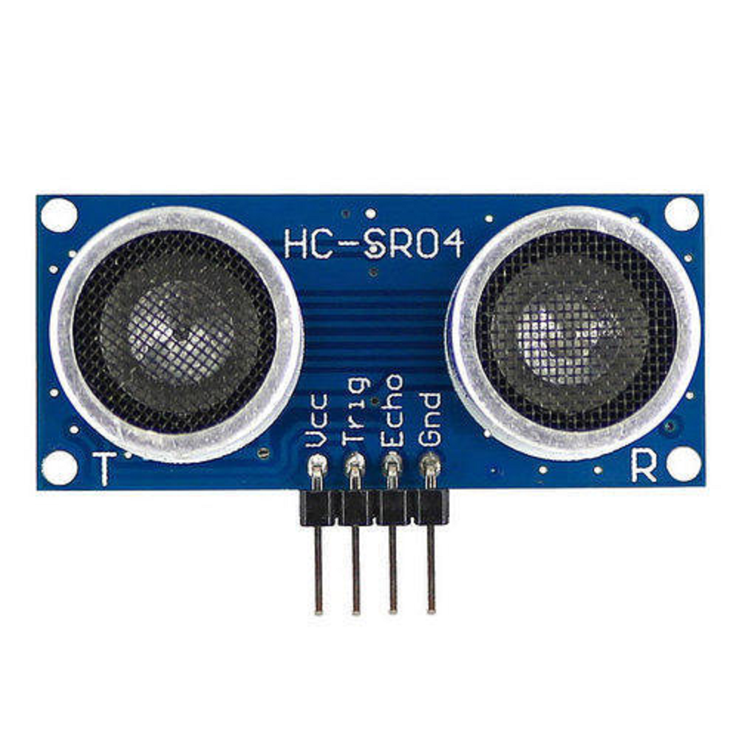
13.Ultrasonic Sensor
What It Does:
Measures the distance between the sensor and an object by using sound waves.
2cm – 4-5m.
Basic Principle:
Emits high-frequency sound waves and measures the time it takes for them to bounce back from an object.
Real-Life Applications:
Distance measurement in robotics, Parking sensors in cars, Object detection in automation.
Future Vision:
More accurate autonomous navigation systems, Advanced object recognition.

Slide 25
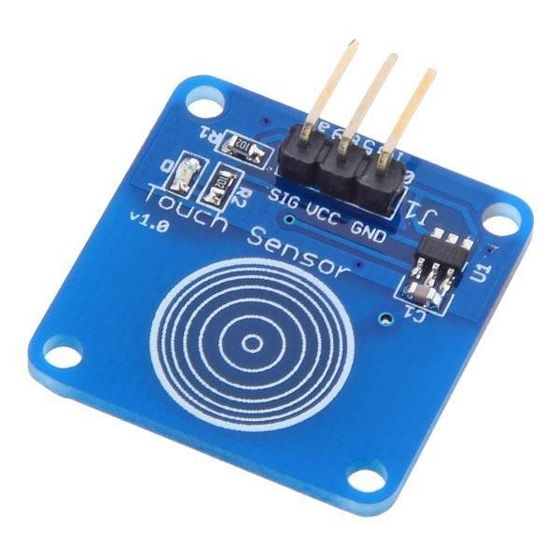
14.Touch sensor
What It Does:
Detects physical touch or proximity.
Basic Principle:
Works on capacitive or resistive principles; changes in capacitance or resistance signal touch.
Real-Life Applications:
Smartphones, Touchscreen devices, Interactive displays.
Future Vision:
Smarter, more responsive touch interfaces, Touch sensors in medical equipment.

Slide 26
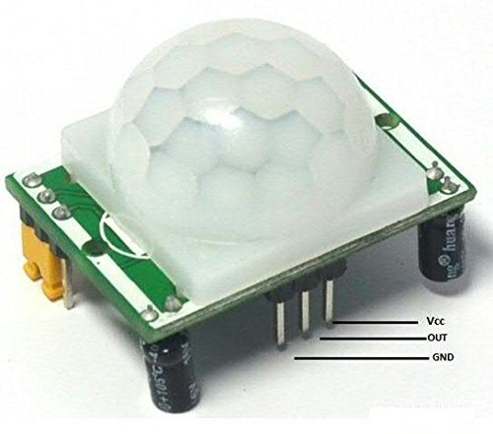
15.Pir sensor
What It Does:
Detects motion by measuring infrared light from objects in its field of view.
5 to 12 meters, 90-110 deg view.
Basic Principle:
Senses changes in infrared radiation levels when an object moves.
Real-Life Applications:
Security systems, Motion-activated lights, Home automation.
Future Vision:
Smarter motion detectors for enhanced security, Motion detection in wearable devices.

Slide 27
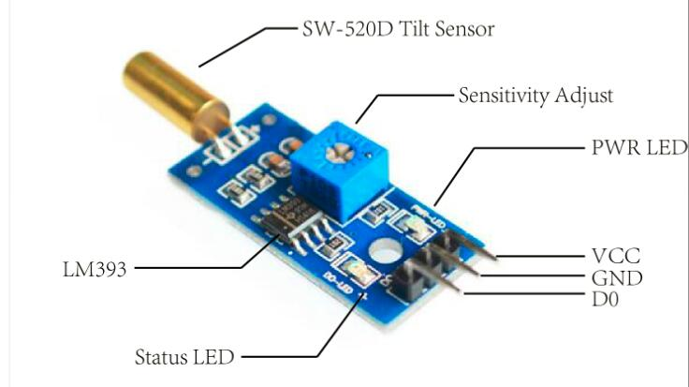
16.tilt sensor
What It Does:
Detects changes in the angle of an object relative to the ground.
Basic Principle:
Uses a rolling ball or liquid to detect tilt by shifting positions when angled.
Real-Life Applications:
Gaming controllers, Mobile devices (screen orientation), Industrial equipment.
Future Vision:
More precise orientation sensing for drones, Advanced tilt detection in robotics.

Slide 28
17. Light Sensors
Light sensors are photoelectric sensors that converts light energy (photons) into electrical energy
Mainly 3 types of light sensors:
Photodiodes
Photoresistors
Infrared

Slide 29
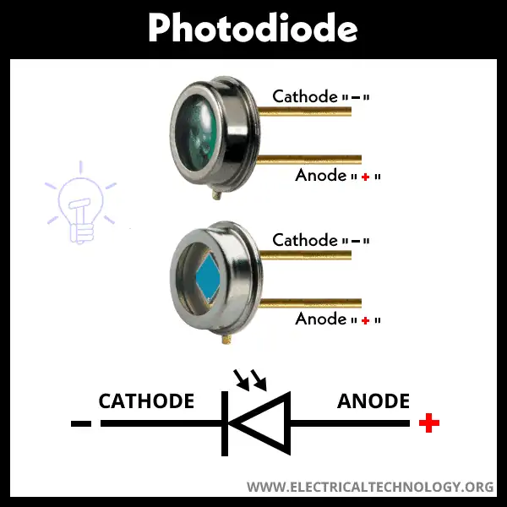
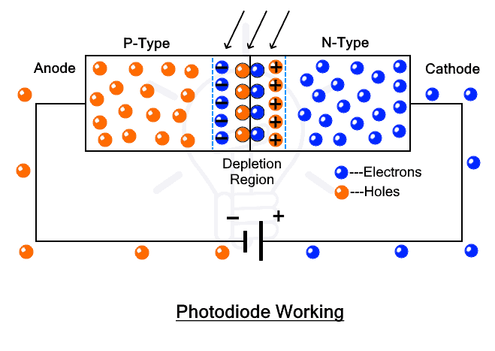
a. Photodiodes
The diode is connected in reverse bias giving rise to negligible current. When light source is illuminated, the reverse current increases and the diode resistance drops.
The measured current is nearly equal to the intensity of the light
Applications :
Used as IR Receiver

Slide 30
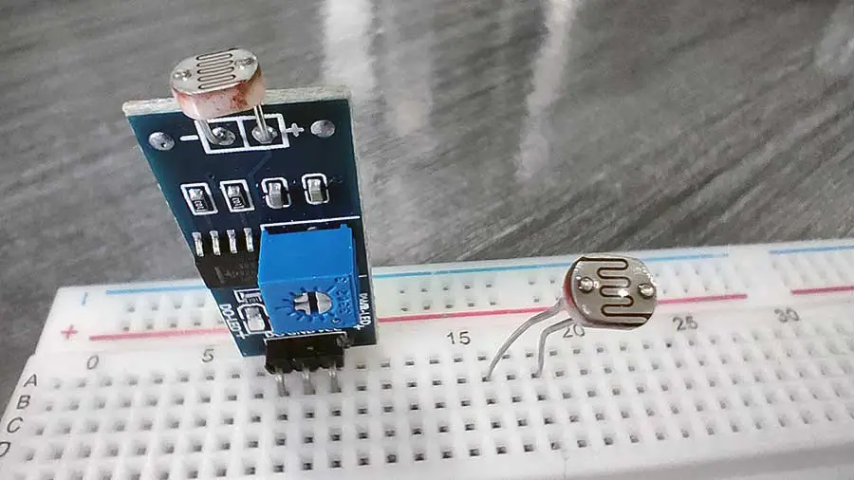
B. PHOTORESISTORS
A photoresistor (or light-dependent resistor, LDR, or photoconductive cell) is a light-controlled variable resistor. The resistance of a photoresistor decreases with increasing incident light intensity (photoconductivity).
The resistance of a photoresistor decreases with increasing incident light intensity (photoconductivity).
It won’t respond if the light is not exactly focused on its surface.
Applications :
Agriculture, Weather monitoring, Temp. Control

Slide 31
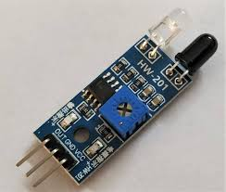
c. Infrared sensors
There are two parts: Transmitter and Receiver
It sends an infrared red signal using IR Led and senses the reflected signal using Photodiode.
Photodiode resistance changes according to the amount of IR radiation falling on it, hence the voltage drop across it also changes and by using we can sense the voltage change and generate the output accordingly.

Slide 32
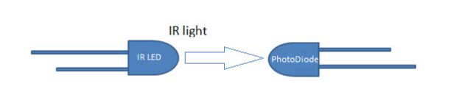
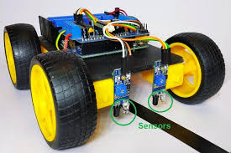
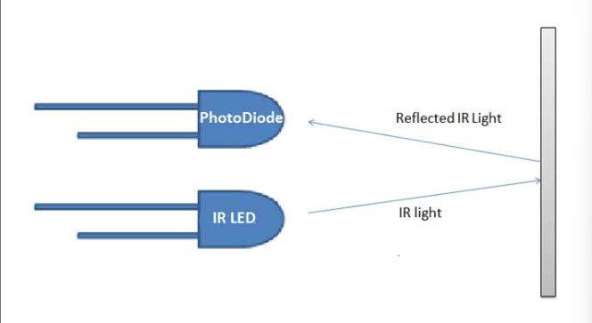
Direct
Indirect
Applications :
Obstacle avoidance, Line Follower, TV remote, infrared thermometer

Slide 33
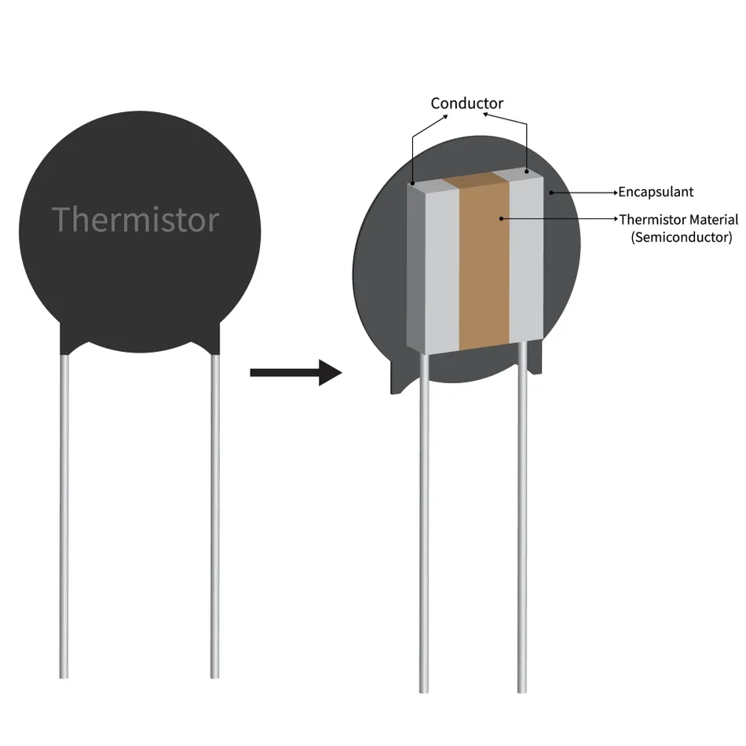
18. Temperature sensors
a. Thermistor
They are made up of pure semiconductors, whose conductivity is due to holes and electrons
When Temp. increases more no. of electrons participate in conduction, induces current.
This change in current flow can be used to determine the amount of change in temperature.
Applications :
Consumer electronics, Battery management system, medical devices, engine temp. monitoring

Slide 34
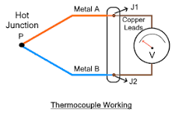
B. Thermocouple
Uses two different types of metals, are kept at different temperatures, potential difference is developed between them, the measure of e.m.f induced is the measure of temp. difference
Applications :
Industrial Process, Aerospace, Food processing, Power generation, exhaust gas monitoring

Slide 35
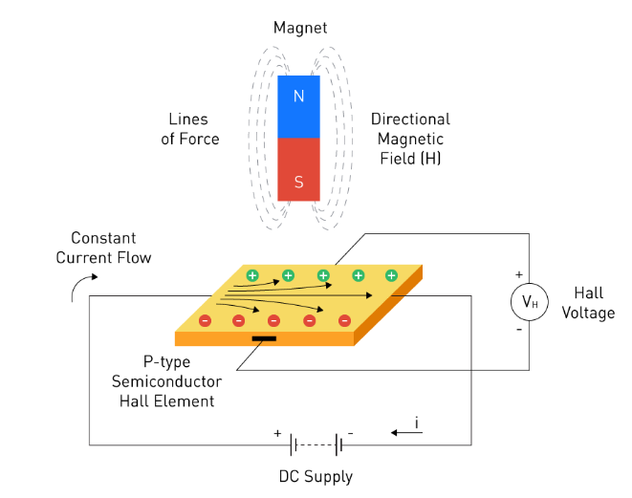
19. Hall effect sensors
Converts magnetic field variations into electric signals, works on the principle of Hall effect .
Hall effect : When current carrying conductor is placed in a magnetic field the electrons flowing through the conductor displaces towards the edges, thus giving rise to voltage difference, called hall voltage. This happens because their own magnetic field is reacting to the contrasting field of the permanent magnet.
The output signal that comes out from a Hall effect sensor represents the density of a magnetic field around the device.

Slide 36
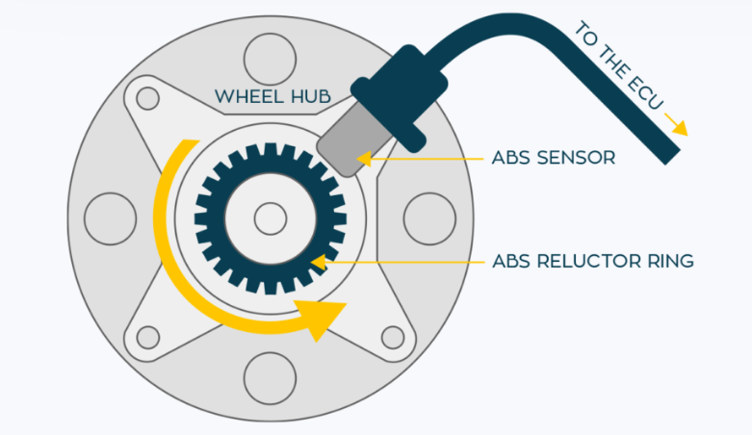
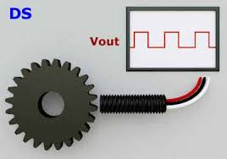
Applications :
Security systems, Anti – lock Breaking systems(ABS) , rotating speed sensors, automatic fuel level indicator
Anti–lock breaking system
Rotating speed sensor

Slide 37
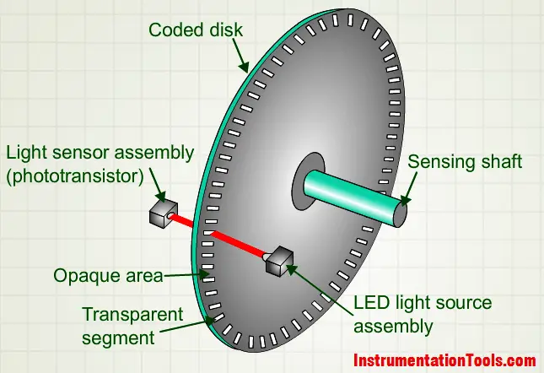
20. encoders
Encoders are used to translate rotary or linear motion into a digital signal.
The encoder sends a feedback signal that can be used to determine position, count, speed, or direction
Applications: CNC, Robotic arms, Position sensing
Optical Encoders

Slide 38
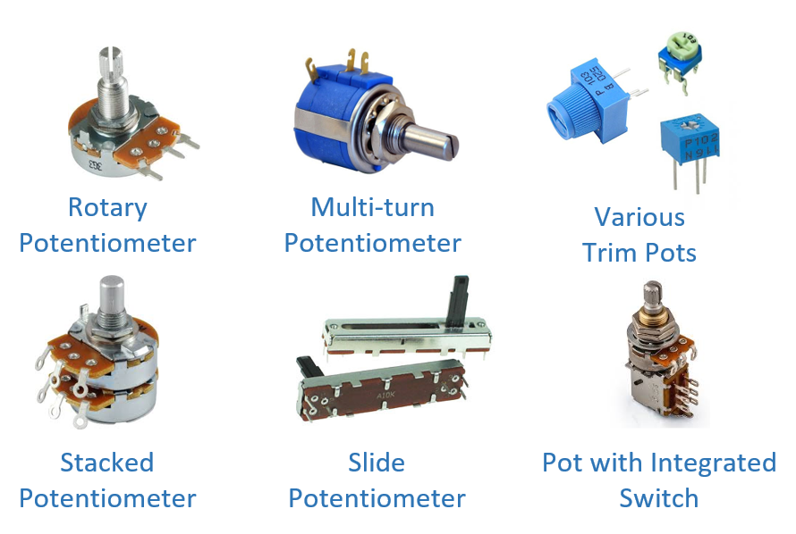
21. Potentiometers
The potentiometer is the three terminal device used for measuring the potential differences by manually varying the resistances
The length is proportional to resistance
High Accuracy
Applications: Volume control in audio equipment, Position sensing (Joystick) Tuning Circuits

Slide 39
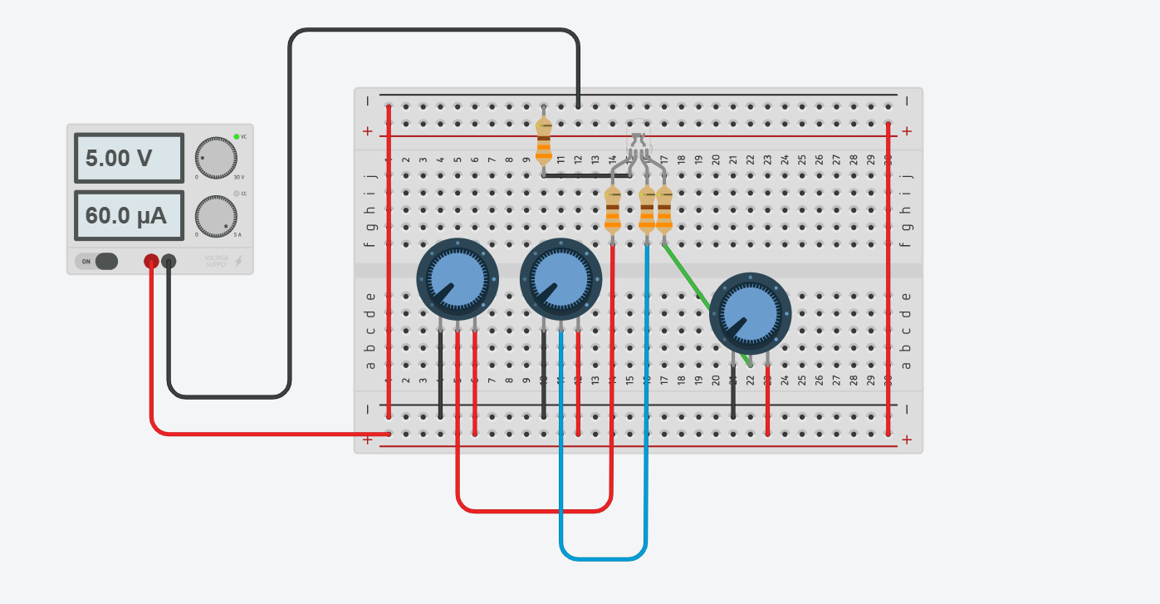
Guess what circuit does??
Circuit

Slide 40
Basics before we dive in.
Microcontroller
vs Microprocessor

Slide 41
Microcontroller | Microprocessor
A small computer on a single integrated circuit that includes a processor, memory, and peripherals. | A central processing unit (CPU) that requires external components like memory, and input/output peripherals to function.
ATmega328 (Arduino), ATtiny85, ESP8266 | Intel Core i7, ARM Cortex-A53, AMD Ryzen
Embedded systems, simple automation tasks, IoT devices | PCs, smartphones, servers, gaming consoles
Integrated (Flash memory, RAM, and EEPROM on the chip) | External (Needs external RAM, ROM, etc.)
Typically, low (designed for power efficiency) | Higher (requires more power for performance)
8-bit, 16-bit, or 32-bit (simpler designs) | Mostly 32-bit or 64-bit (for complex tasks)

Slide 42
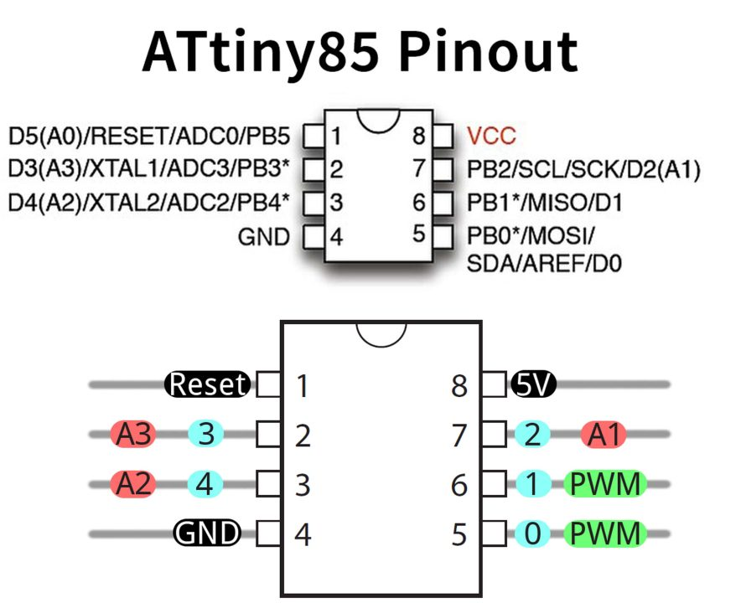
Attiny85
ATtiny chips are tiny and easy to use in small projects.
They use very little power, making them great for battery-operated devices.
ATtiny microcontrollers are inexpensive and widely available.
Ideal for projects like small robots, sensors, and simple electronics.

Slide 43
Gpio pins
Also known as General Purpose Input Output Pins, GPIO pins are a standard interface to connect microcontrollers with other electronic devices.
GPIO pins can be configured as either input (receiving data) or output (sending data). Some pins can also support analog input or PWM output.
GPIO pins are versatile and used for many purposes, such as reading sensor data (input) or controlling devices like LEDs and motors (output).
When configured as output, GPIO pins send high (1) or low (0) signals to connected devices.

Slide 44
Analog and Digital pins
Analog I/O Pins | Digital I/O Pins
Can output varying voltages from 0V to 5V | Can only output 0V or 5V (binary)
analogRead(), analogWrite() | digitalRead(), digitalWrite()
Can read both analog and digital signals | Can only read digital signals
Used for devices that need variable control (e.g., light dimming, motor speed control) | Used for on/off control, like turning LEDs or relays on and off

Slide 45
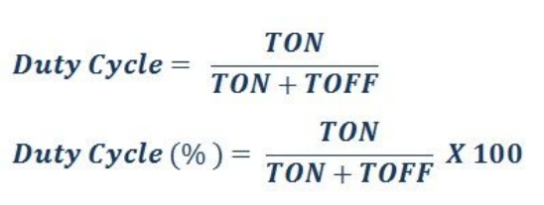
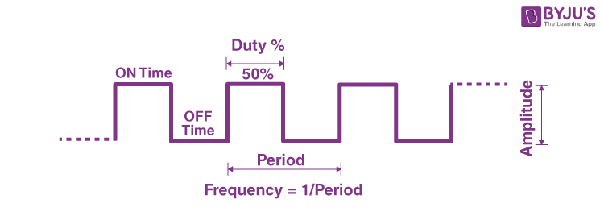
PWM (Pulse Width Modulation)
PWM is used to send analog signals through a digital I/O pin.
This is achieved by sending pulses of power within a very short interval of time.
Voltage output=Voltage supplied by the pin x Duty cycle
PWM is commonly used for controlling motor speed, dimming LEDs, and generating audio signals.

Slide 46
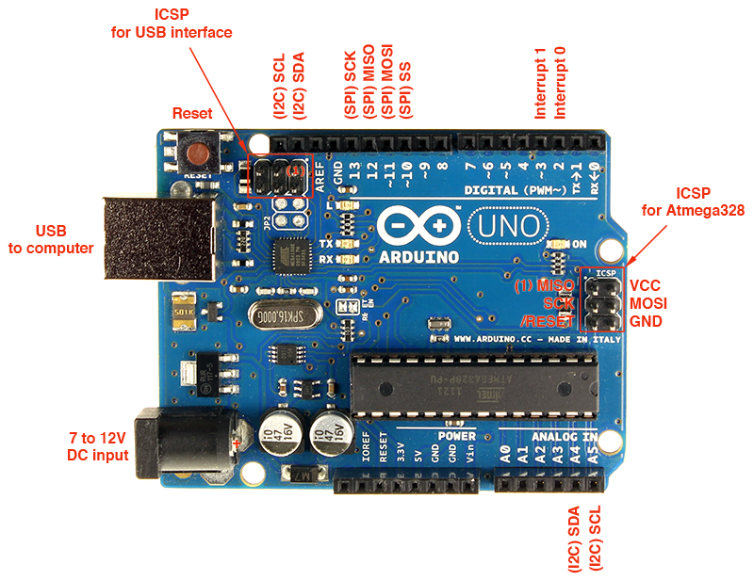
Arduino uno
USB Interface: Connects the board to your computer for uploading code and also powers the board.
Power Input (7-12V): Can power the board through an external DC power supply if not using USB.
Reset Button: Manually resets the microcontroller to restart your program.
Digital I/O Pins (0-13): These pins can be used as either input or output and are used to interface with external components like sensors, LEDs, or motors. Pins 3, 5, 6, 9, 10, and 11 support PWM.
Analog Pins (A0-A5): Used to read analog signals (e.g., from sensors like temperature or light sensors) and convert them to digital values.

Slide 47
Arduino uno
Power Pins: Provides 3.3V, 5V, GND, and a reset pin for powering external circuits.
TX/RX LEDs: Indicate serial communication (data transmission and reception).
ATmega328P: The main microcontroller that runs your code.
Minimum Input: 7V (Below this, the onboard regulator may not be able to supply a stable 5V).
Maximum Input: 12V (Going beyond 12V could cause the regulator to overheat, although the absolute maximum is 20V, but not recommended).

Slide 48
Arduino uno
I2C (Inter-Integrated Circuit)
Allows the Arduino to communicate with multiple devices (like sensors or displays) using just two wires.
Pins: A4 (SDA) and A5 (SCL).
One device acts as a master (usually the Arduino) and others as slaves. Data is sent over the SDA line, and the SCL line keeps everything in sync.
Example: Connecting an LCD screen or a temperature sensor.

Slide 49
Arduino uno
SPI (Serial Peripheral Interface)
Faster communication for connecting things like SD cards or displays.
Pins: 10 (SS), 11 (MOSI), 12 (MISO), and 13 (SCK).
Devices communicate faster using separate lines for sending and receiving data. The SS pin decides which device to talk to.
Example: Reading from an SD card or controlling an OLED display.

Slide 50
Arduino uno
UART (Serial Communication):
Allows the Arduino to communicate with your computer or another device.
Pins: 0 (RX) and 1 (TX).
Data is sent and received using two pins—one for sending (TX) and one for receiving (RX).
Example: Sending data to a Bluetooth module or displaying serial data on your computer.

Slide 51
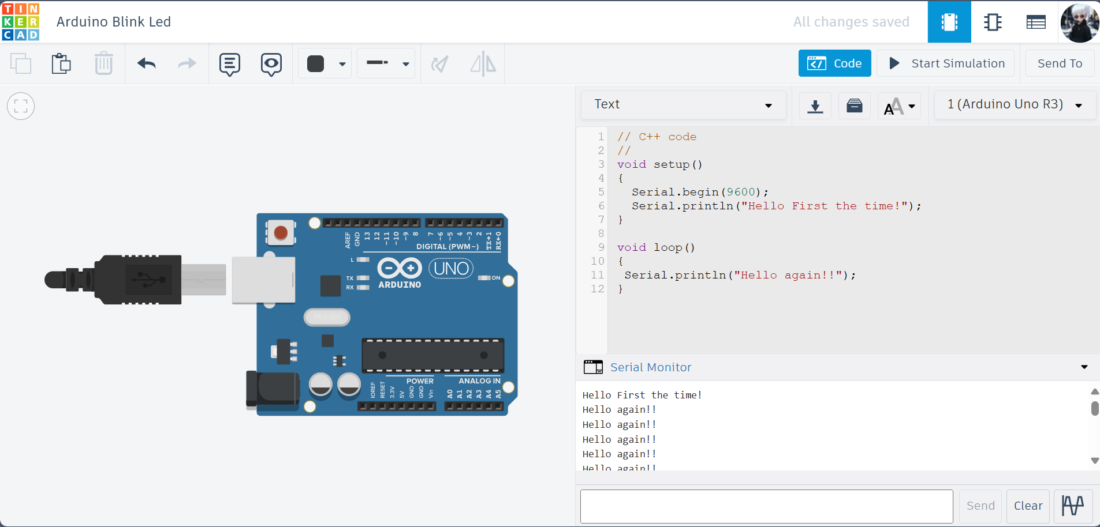
Hello to the Arduino world
Runs once, when you power/reset; usually contains the definition of input output pins, communication begin etc..
Runs the code in a loop, used for repetitive tasks such as running a motor etc..

Slide 52

Working with Arduino
Setting up Led pin number, Pin 13 is defined as led pin by default.
Code to give max power for 1 second and no power for the next 1 second.

Slide 53

Fun little game on lcd
Play

Slide 54
Resources
ThinkerCAD Official - https://www.tinkercad.com/blog/official-guide-to-tinkercad-circuits
DroneBot Workshop –Don’t conclude this channel is just for drones from the name, This guy made a very comprehensive Guide for Arduino and few other micro controllers, many of his videos cover wide variety of sensors as well, do check out.
- https://www.youtube.com/playlist?list=PLWNDWPAClRVoIZzsX-SkR5Br0_ZtRscxZ
Arduino Cloud -Getting Started with Arduino Cloud | Arduino Documentation
For those who want to go beyond Arduino we have ESP32 -https://www.youtube.com/playlist?list=PLWNDWPAClRVqNUIuJylljkQfFSeIpuxUi

Slide 55


CONNECT WITH US
WHATSAPP
INSTAGRAM

Slide 56
The end

